Slide 1
Introduction to AI
CT017-3-1 Ver 1.0
Intro to Neural Network
Background music
https://www.youtube.com/watch?v=EWD8JhDlZ1s

Slide 2
Recap
What are the areas of AI
AI
Expert Systems
Robotics
Computer Vision
NLP
Neural Network

Slide 3
Recap - Quiz
Please answer the quiz of 10 questions
https://forms.office.com/Pages/ResponsePage.aspx?id=owPtDy1AM0aozYswiCIlPsY9uXBbs21PvtqJ40sBFdBUODU4TlNXWlZFQlJFQTZLOU9LWTM2RjU5Uy4u

Slide 4
Topic & Structure of the Lesson
What is Neural Net/Network
What is Machine Learning

Slide 5
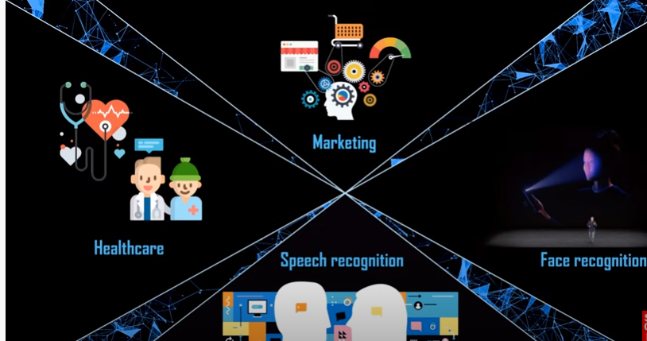
Areas of Neural Network

Slide 6
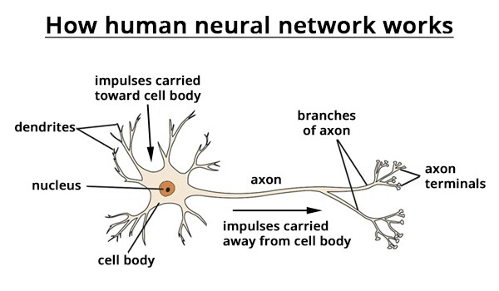
What is Neural Net in humans?
Neural nets are an attempt to model the human brain to solve problems;
The human brain is made up of special nerve cells called neurons;
Each neuron receives inputs (form its dendrites) and gives outputs (through its axon)

Slide 7
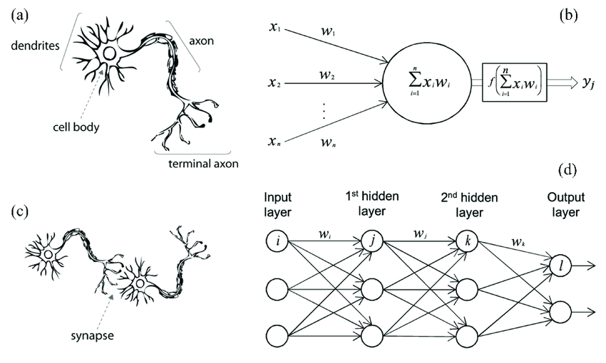
Continues – human nn
It is possible to create artificial neurons, with several inputs and an output;
An output is triggered if the sum of the inputs (each multiplied by its "weight") exceeds a threshold value;
The human brain has millions of highly interconnected neurons;

Slide 8
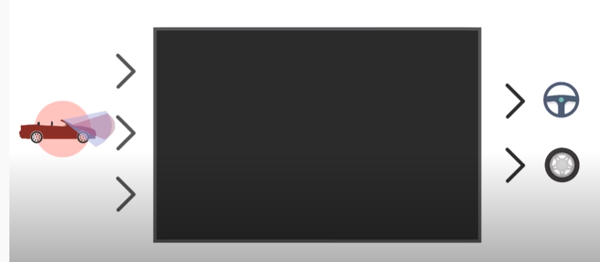
Concept in self driving car
Imagine a Neural Network as kind of black box, which has 1 or many input ex . the sensors of a self driving car, processing them into 1 or multiple output like the controls of the car.

Slide 9
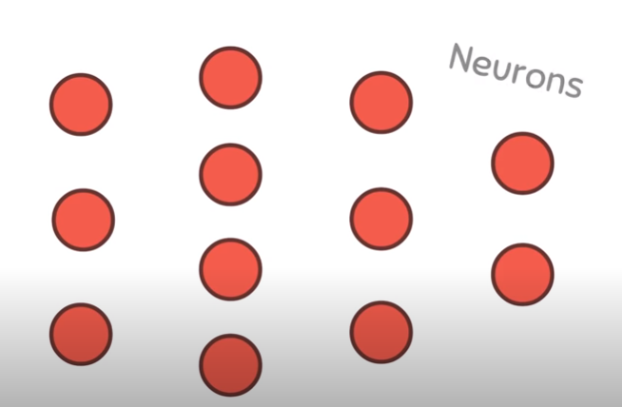
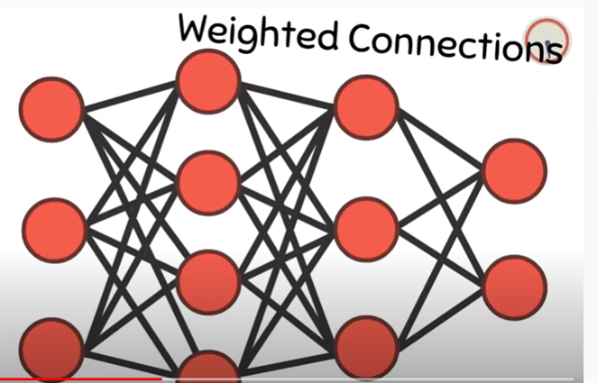
Continues - Neuron
The neural network itself consists of Neuron
Many small units called “Neuron”.
These Neuron are grouped into several layers.
Units of one layer interact with the neurons of the next layer through weighted connection which really are just connections with a real-valued number

Slide 10
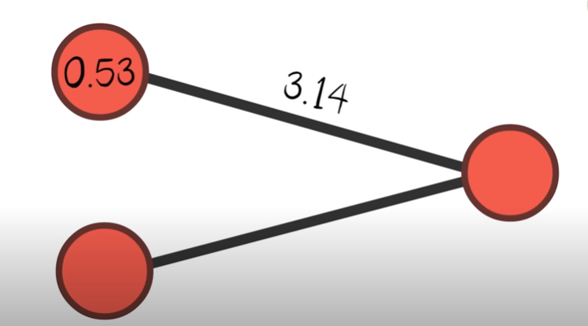
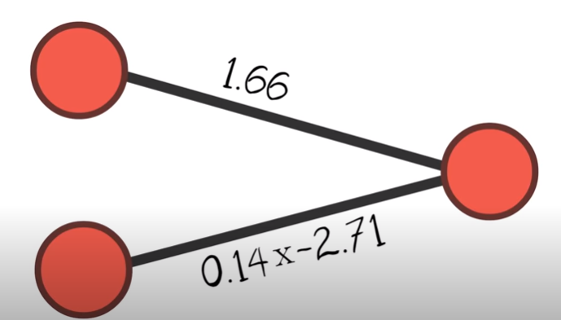
Continues -Weight
Attached to them. A neuron takes the value of a connected “weighted connection’ which are a real valued number attached to them.
A neuron takes the value of a connected. Neuron and multiply, it with their connection’s weight.
The sum of all connected Neurons and the neuron’s bias value is then put into a so-called activation function which is simply mathematically transform the value before it finally can be passed on to the next Neuron.

Slide 11
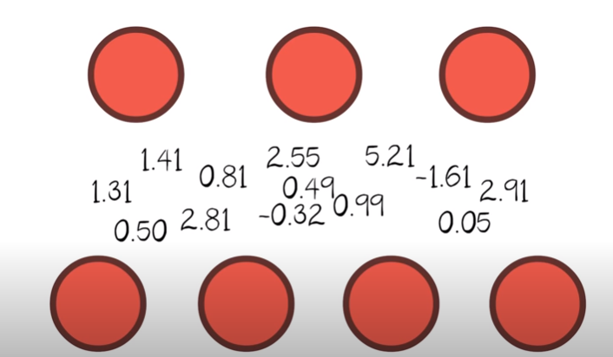
Continues – machine learning
This way the inputs are propagated through the whole network.
That’s pretty much all the network does but the real deal behind neural networks is to find the right weights in order to get the right results.
This can be done through a wide range of techniques such as machine learning

Slide 12
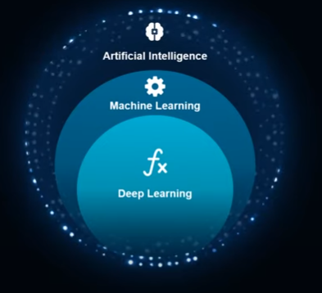
How’s related to AI

Slide 13
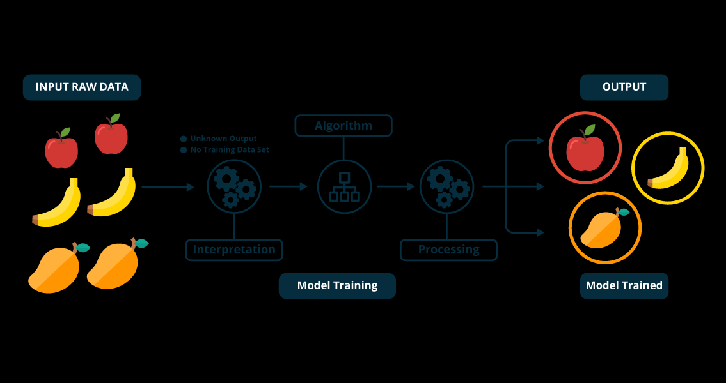
Neural Network video
https://www.youtube.com/watch?v=bfmFfD2RIcg

Slide 14

Activity
AI for Ocean : train the system
https://studio.code.org/s/oceans/lessons/1/levels/1

Slide 15
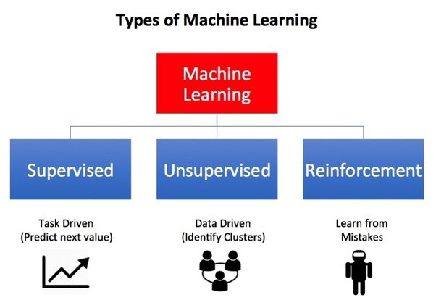

Slide 16
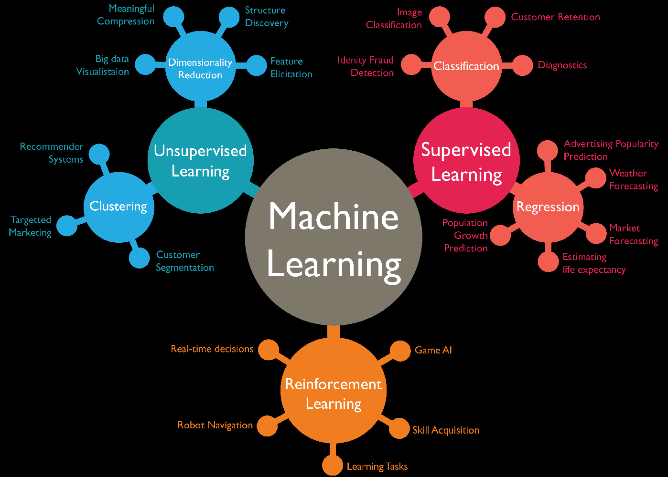

Slide 17
Top 5 Uses of Neural Networks! (A.I.)
https://www.youtube.com/watch?v=i9MfT_7R_4w
Real Life Applications of Neural Networks
https://www.youtube.com/watch?v=idglu_290Wo

Slide 18
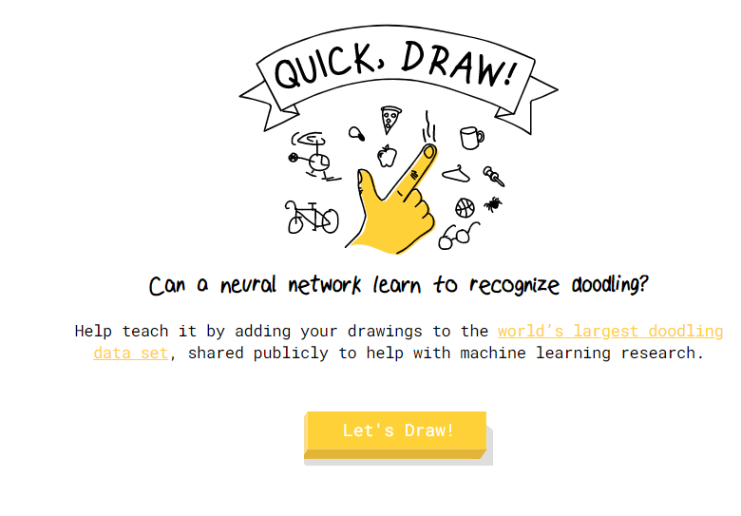
Activity
Lets try this draw something
https://quickdraw.withgoogle.com/%20%E2%80%8B

Slide 19
Summary
In a neural net, the artificial neurons are arranged in several layers (an input layer, some hidden layers, and an output layer);
A neural net has to be trained; in the training process, the weight of the links are adjusted until the net gives correct responses;
The training of the net is an iterative process;
A neural net is non-deterministic (unlike a normal algorithmic program whose output can be predicted with certainty)
Neural nets have proved very successful in pattern matching applications
Neural nets can be software models, or hard-wired.

Slide 20
Tutorial
1. How do artificial neural systems learn?
2. Name three commercial uses of ANSs.
3. Name two specific tasks where ANSs are used.

Slide 21
Question and Answer Session
Q & A

